Slide 1
Our (R) interpretations
Notes:
https://www.epa.gov/system/files/documents/2024-02/pm-naaqs-overview.pdf
https://www.who.int/news-room/feature-stories/detail/what-are-the-who-air-quality-guidelines

Slide 2
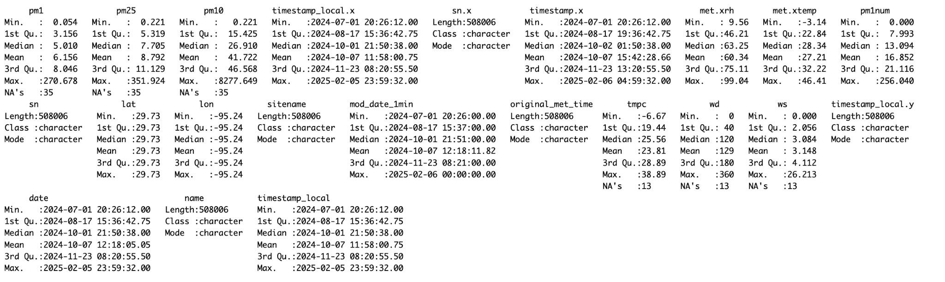

Slide 3
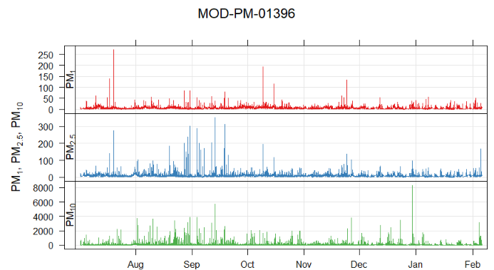
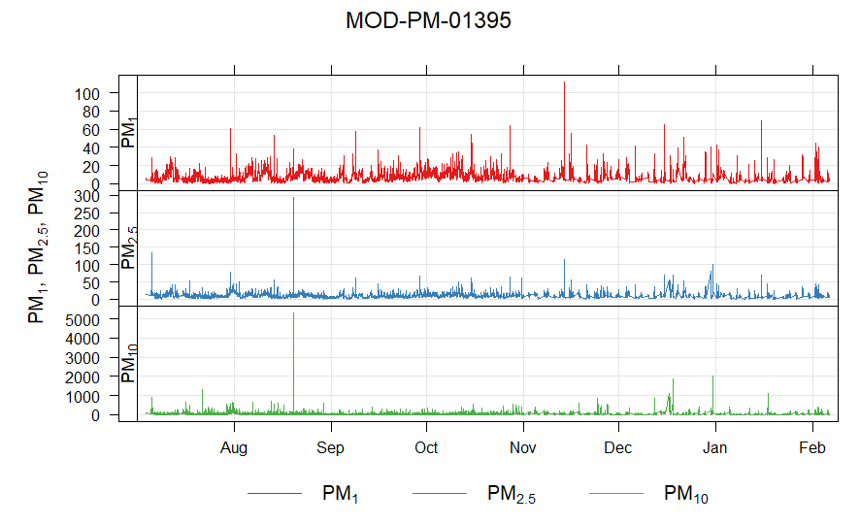
Time series
Time plot just pm 10 y axis limit

Slide 4
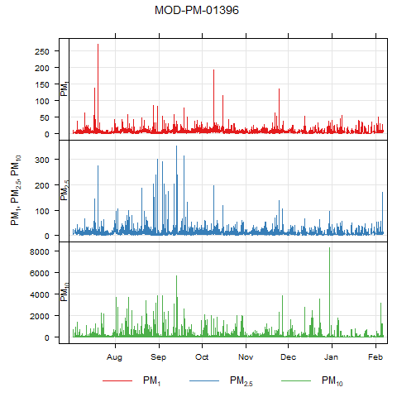
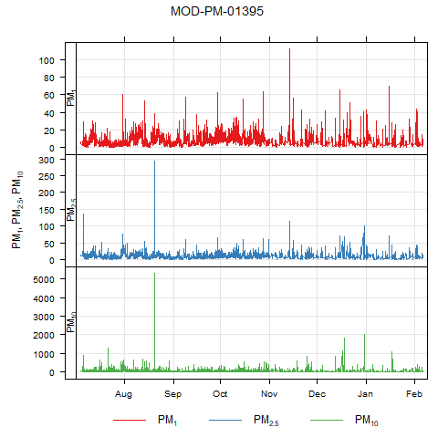
timePlot (Time series)

Slide 5
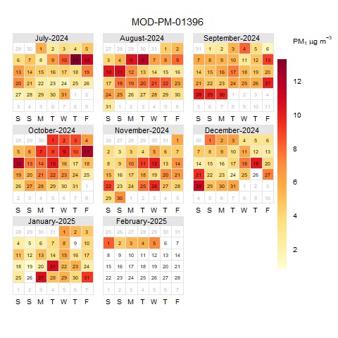
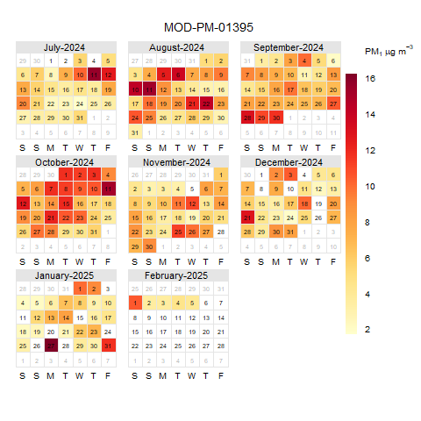
calendarPlot (pm1)

Slide 6
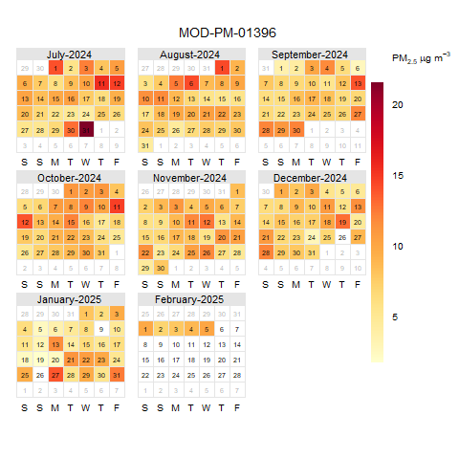
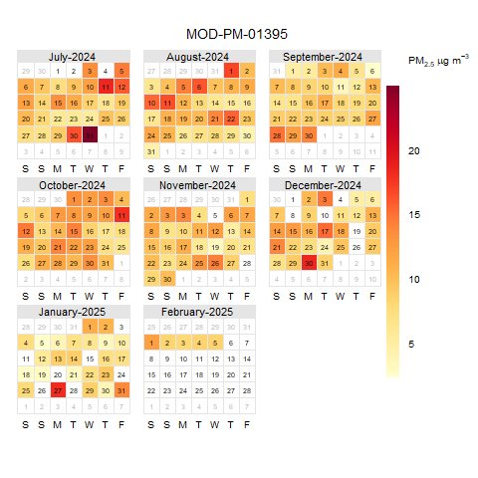
calendarPlot (pm2.5)

Slide 7
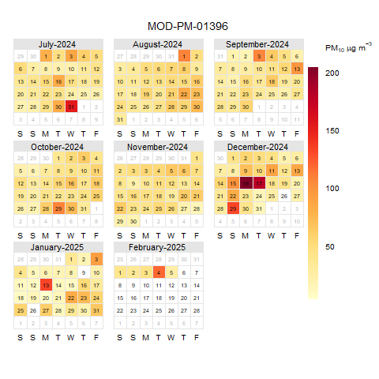
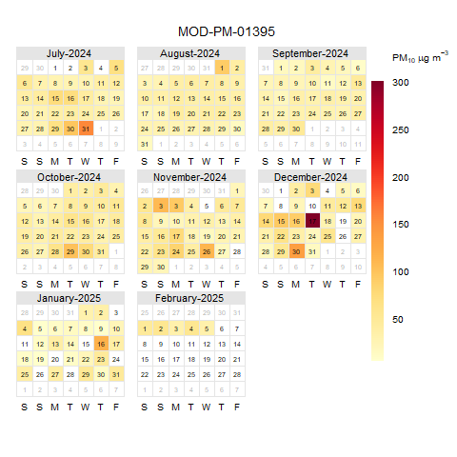
calendarPlot (pm10)

Slide 8
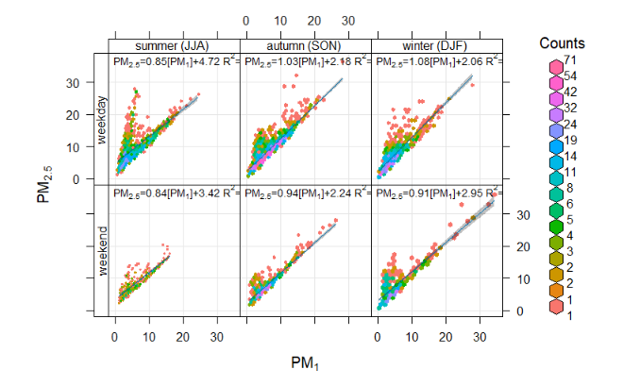
Z- month, hour
P10 v 2.5

Slide 9
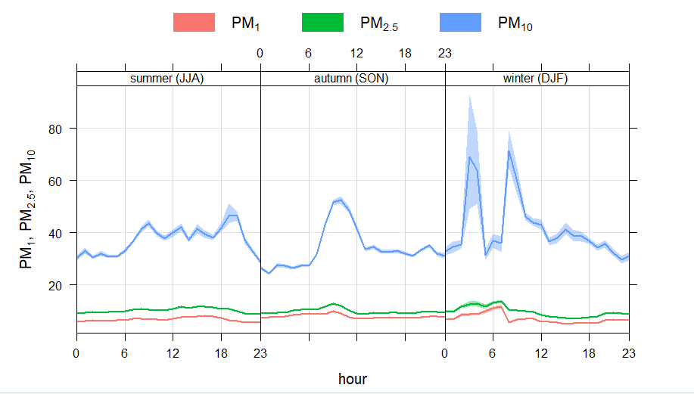
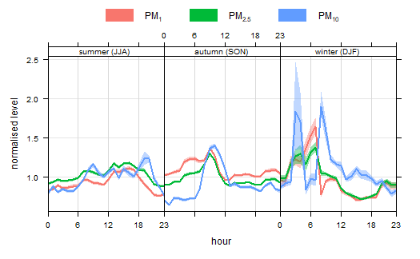
Pm 10 for 16-27 v rest

Slide 10
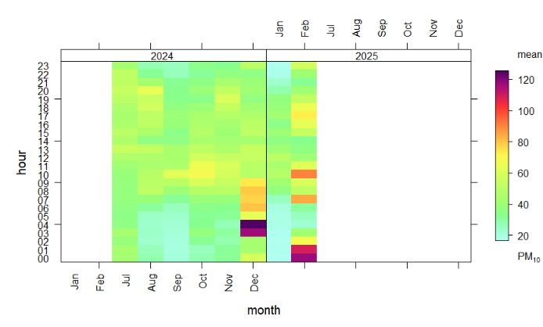
Avg poll per hour in a given month

Slide 11
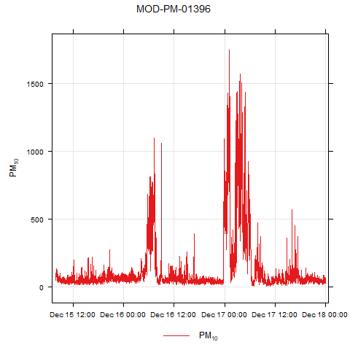
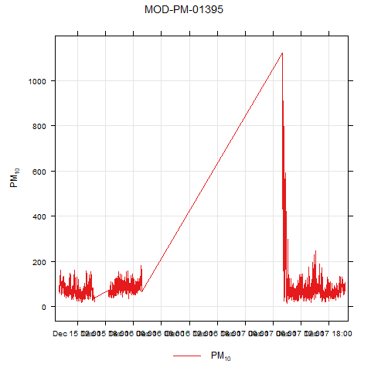
timePlot (12/15-12/18)
Notes:
Follow up with dr. grace lewis about any issues

Slide 13
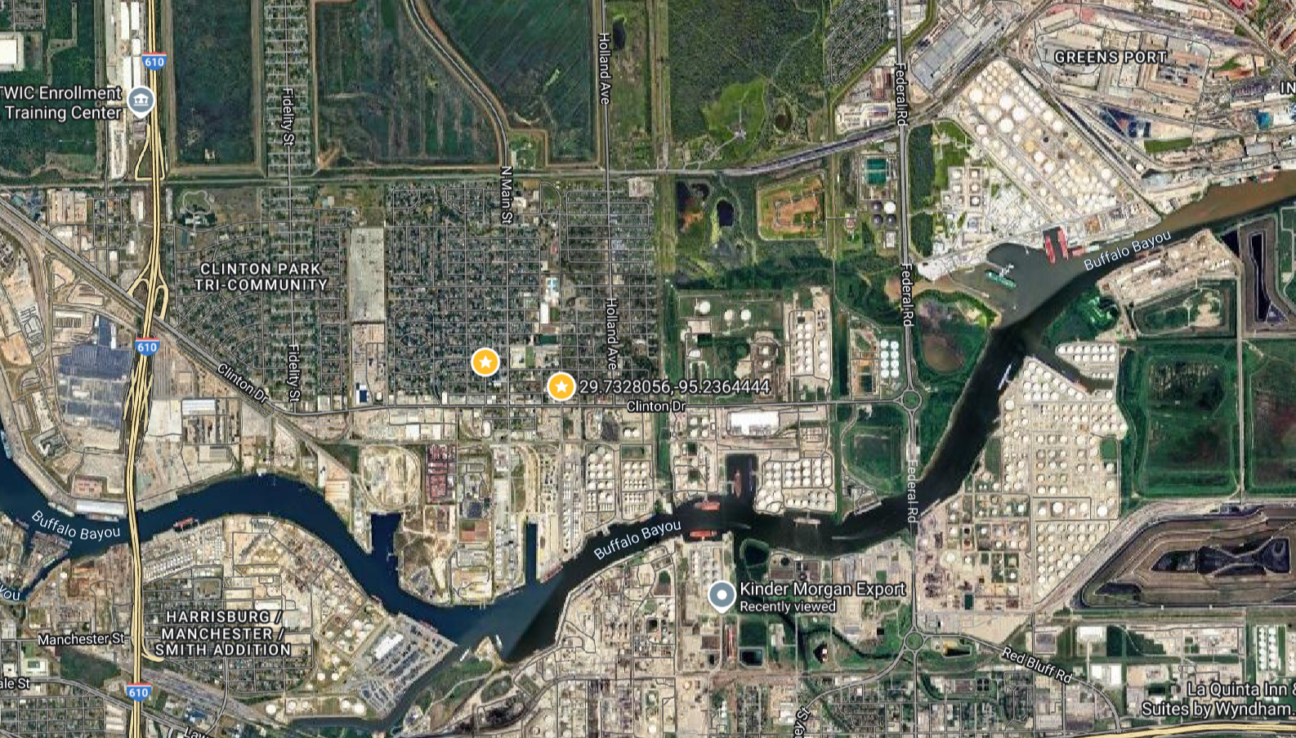
Sensors
MOD-PM-01395 (North West)
29.73422
-95.24181
29°44'03.2"N 95°14'30.5"W
MOD-PM-01396 (South East)
29.73264
-95.23653
29°43'57.5"N 95°14'11.5"W

Slide 14
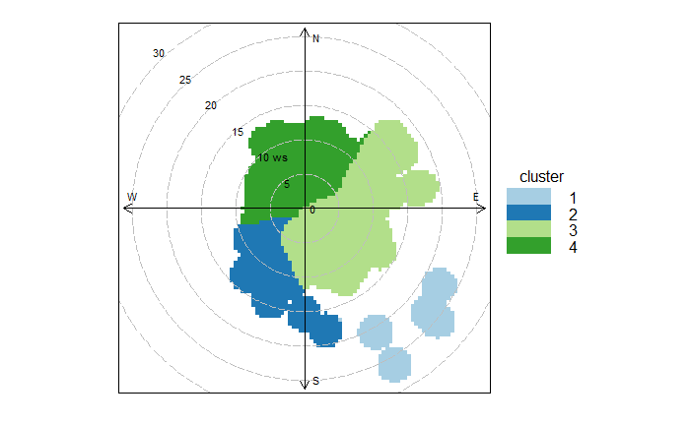
polarPlot

Slide 15
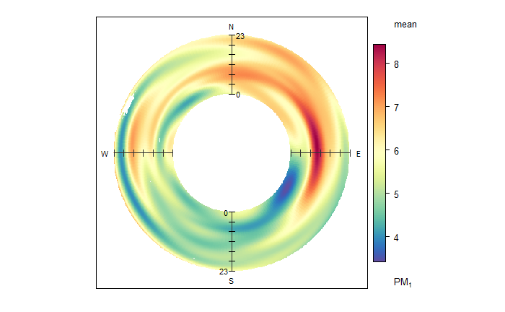
polarAnnulus (PM1)

Slide 16
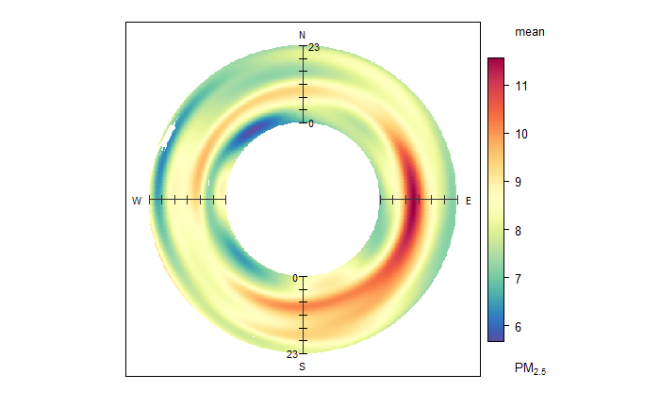
polarAnnulus (PM2.5)

Slide 17
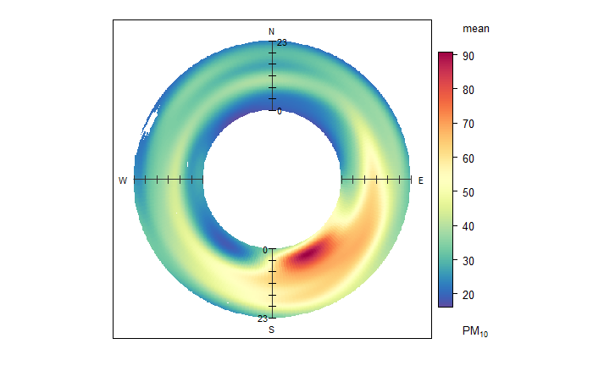
polarAnnulus (PM10)

Slide 18
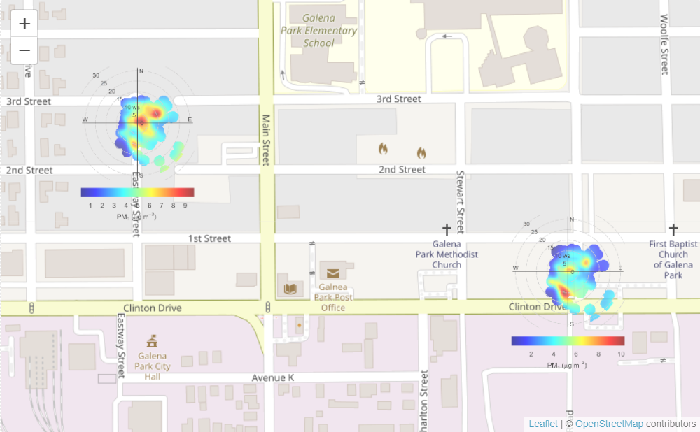
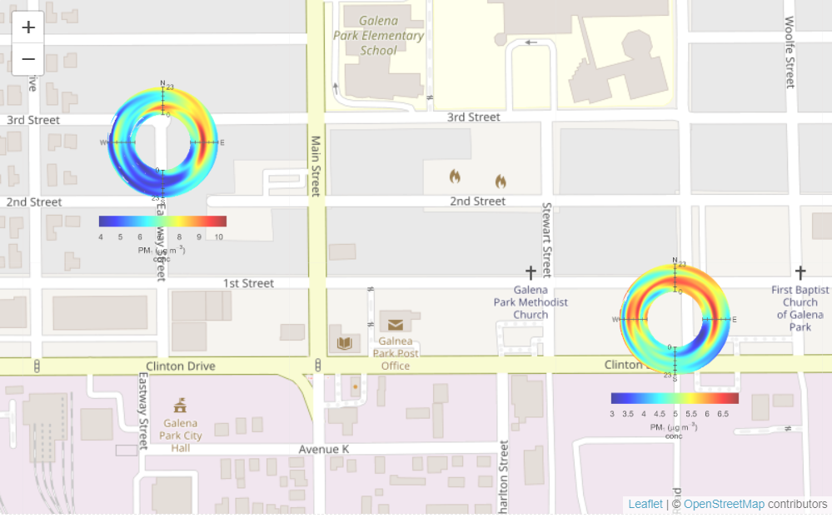
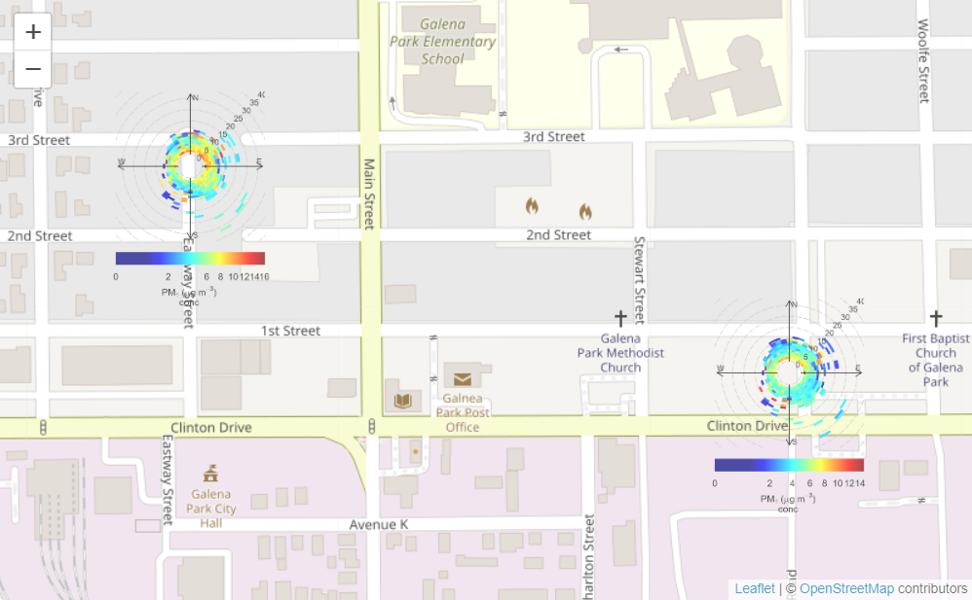
polarMap pm 1
Notes:
Dec 16 17 vs everything else

Slide 19
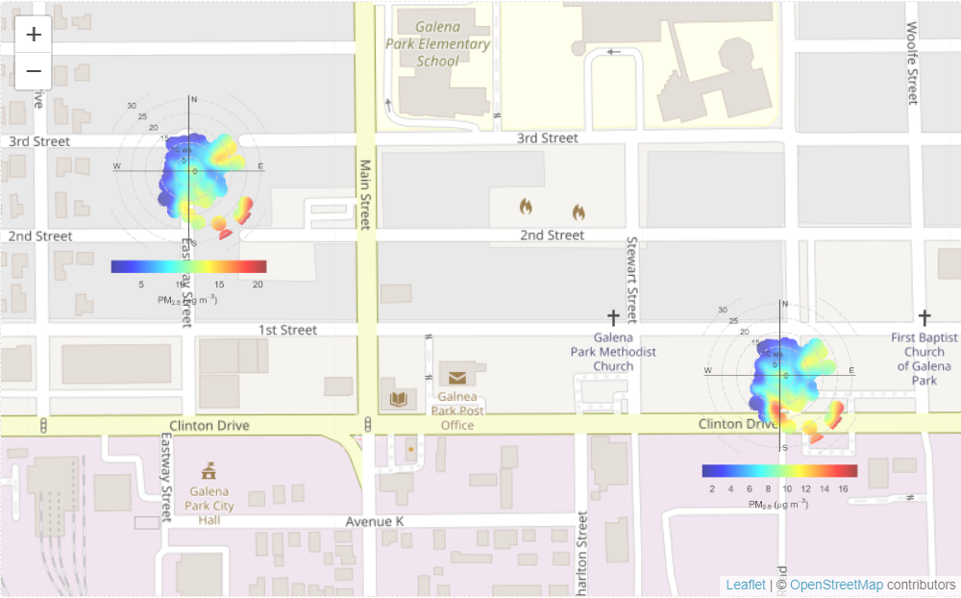
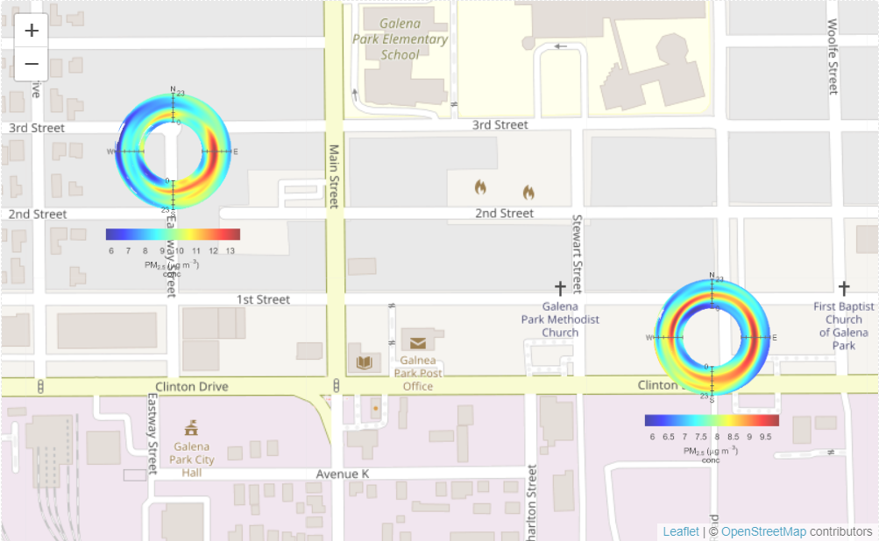
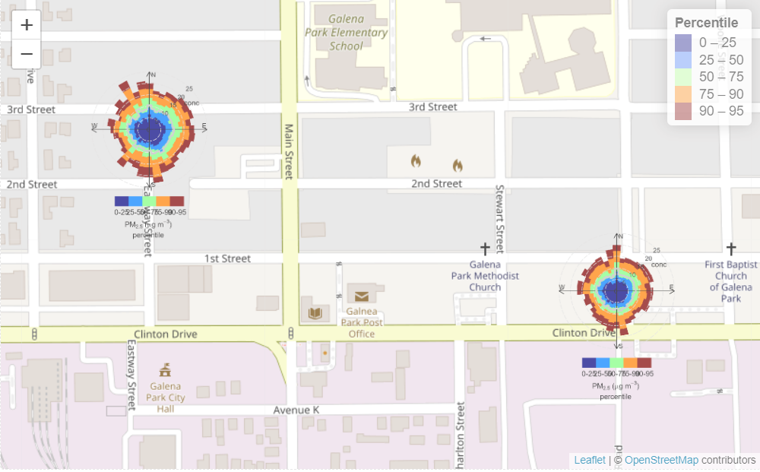
polarMap pm2.5

Slide 20
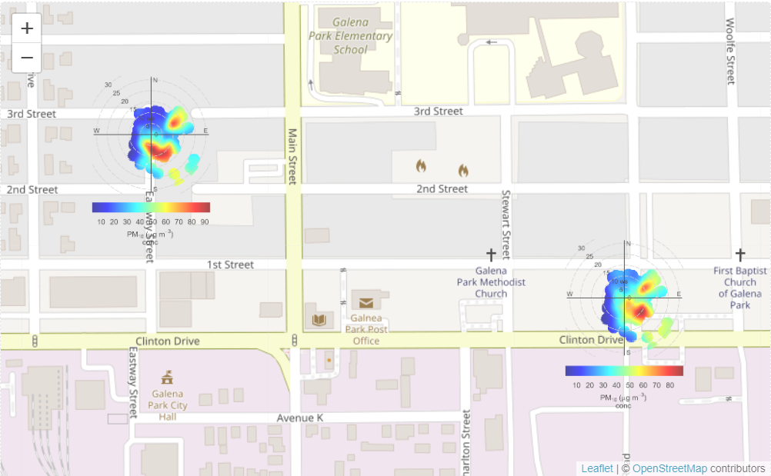
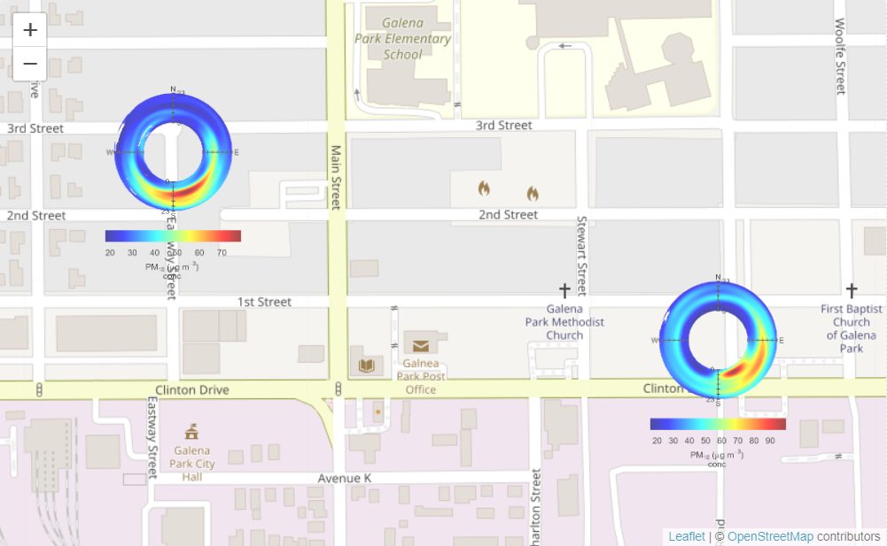
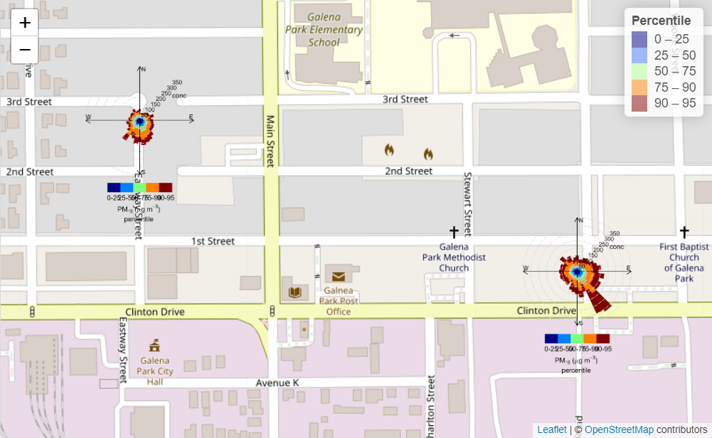
polarMap pm10

Slide 21
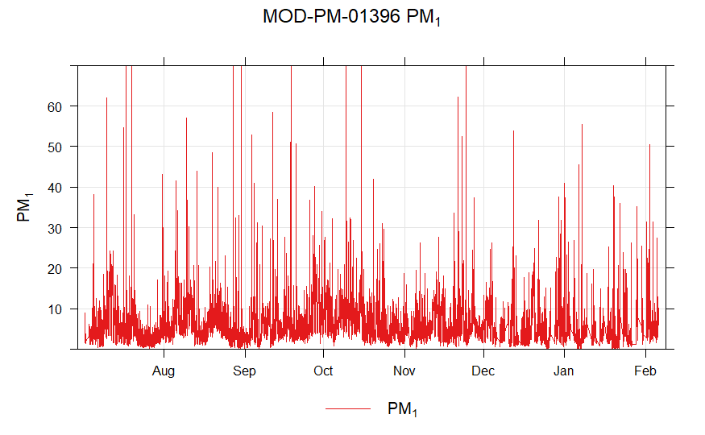
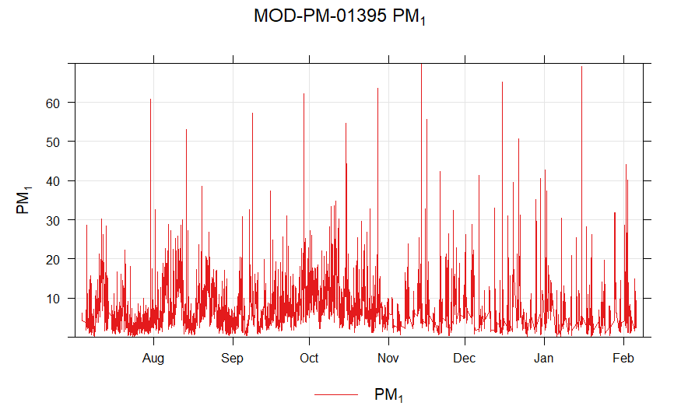
Time Series (pm 1) - Limited y-axis

Slide 22
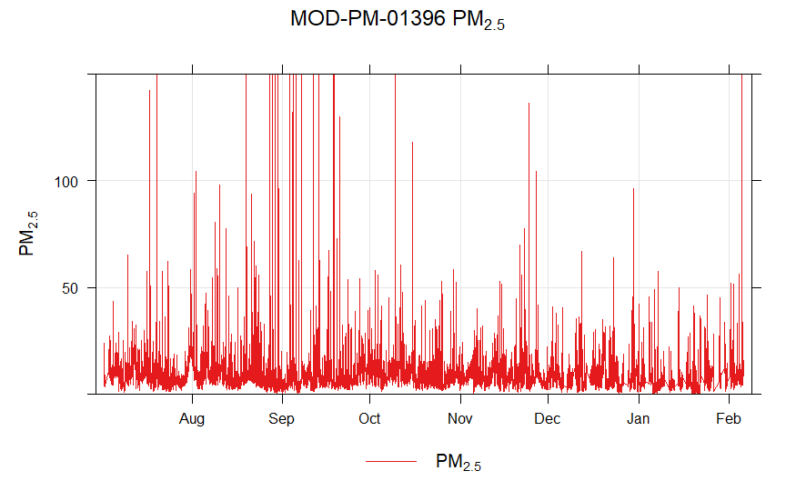
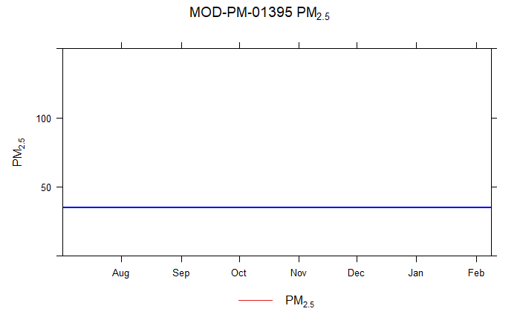
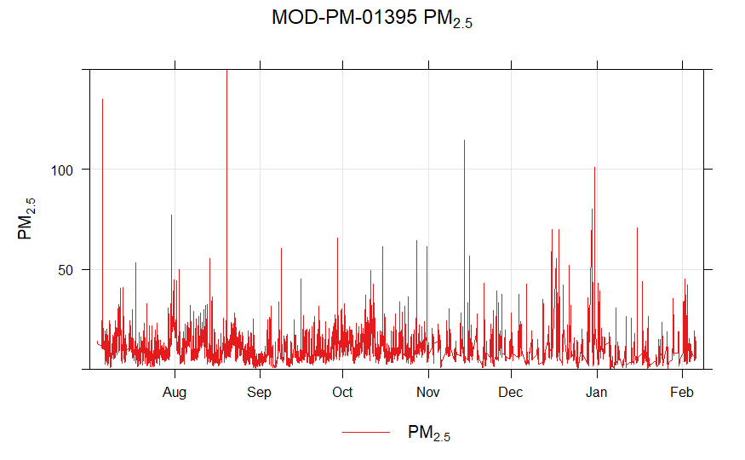
Time Series (pm 2.5) - Limited y-axis

Slide 23
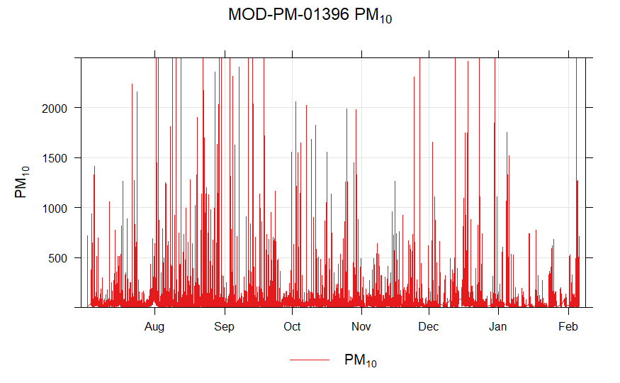
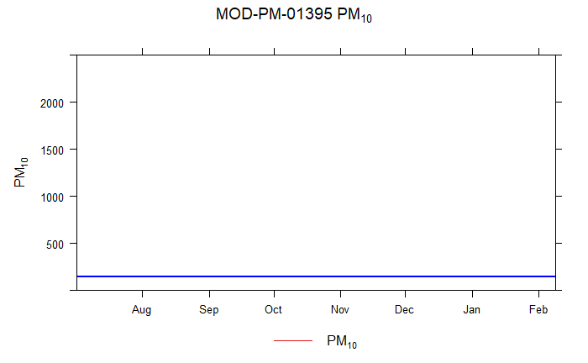
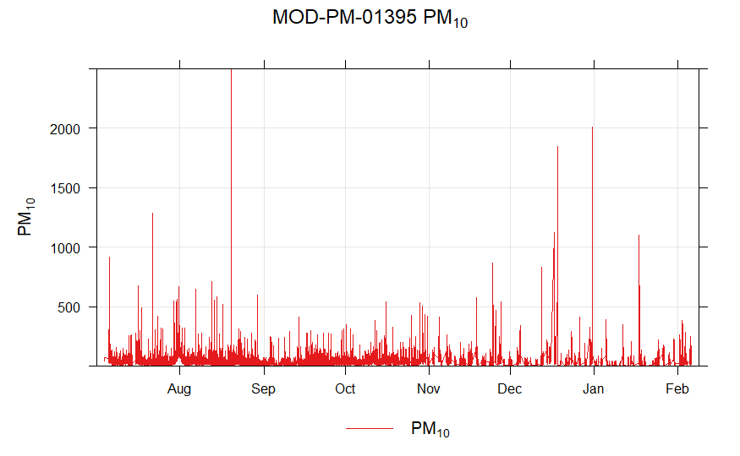
Time Series (pm 10) - Limited y-axis

Slide 24
Things to do: 2/18
Limit y-axis time series plots to more details
Try to create stories resulting from the data
Recreate timeVariation plot (Slide 9) with max y-axis of 18/20 to show more details of p2.5 and p1
Noticed that there are generally in create in pollution at 6am; create polar plots of both pm1 and pm2.5 on an hour bases to see if there is actually a pattern
Create a more clear scatterplot and change variables; compare 2.5 and 10 with the z value being hours/month
Create the timeline on the Miro board
Find average of pm 1,2.5 (24 hour average should be 9 (EPA)),10
Potentially get into contact with Dr. Grace Lewis about any issues from dec 16-17
Notes:
More kid friendly
Connecting to what experience and feel within environment

Slide 25
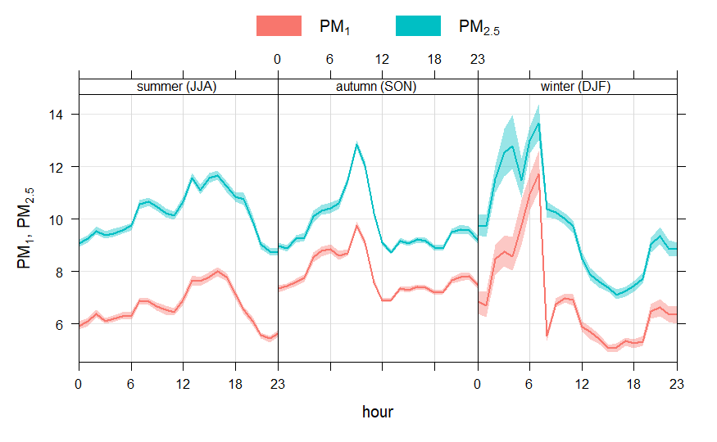
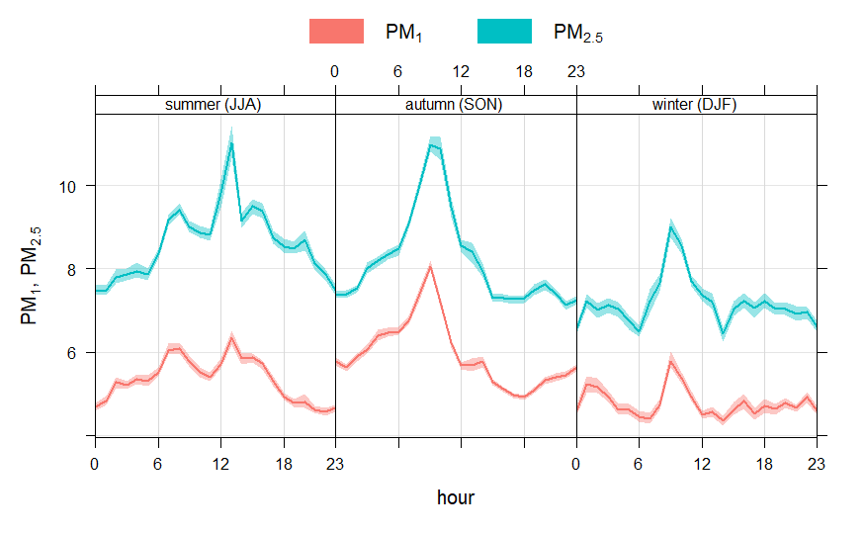
Diurnal Profiles (PM1 & 2.5)

Slide 26
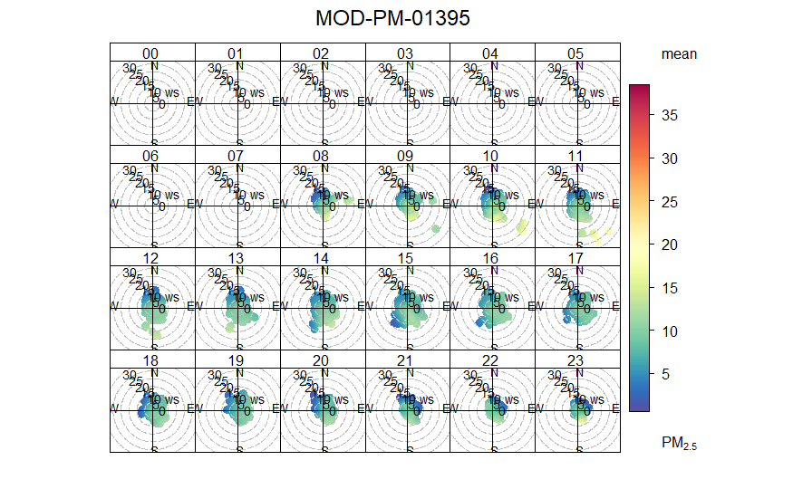
Polar plot (pm 2.5)
Hourly basis

Slide 27
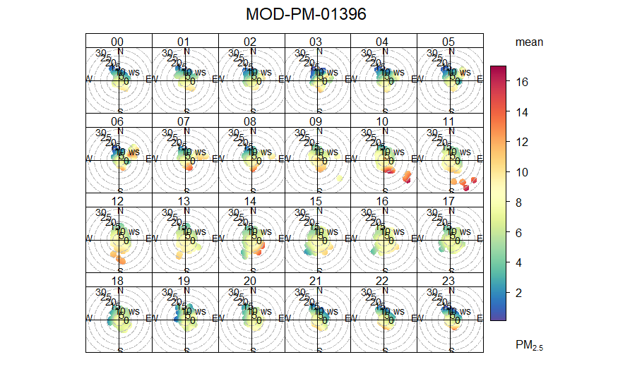
Polar plot (pm 2.5)
Hourly basis

Slide 28
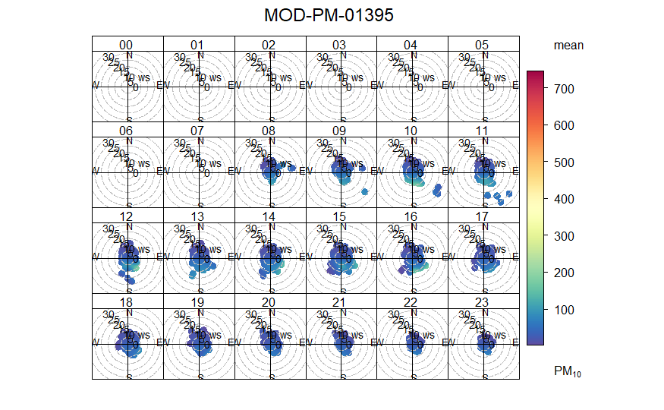
Polar plot (pm 10)
Hourly basis

Slide 29
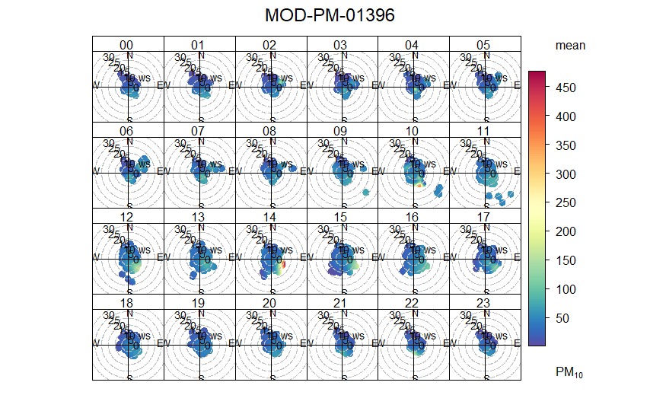
Polar plot (pm 10)
Hourly basis

Slide 30
Things to do: 2/20
Cole
Removing some of the data and making the graphs without
Q
Trend level + remove the outliers and compare
Get started with presentation

Slide 31
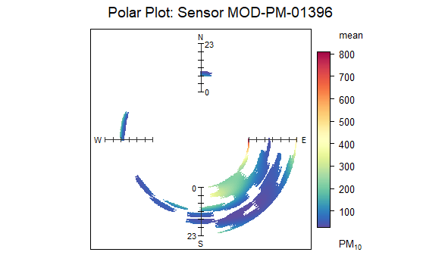
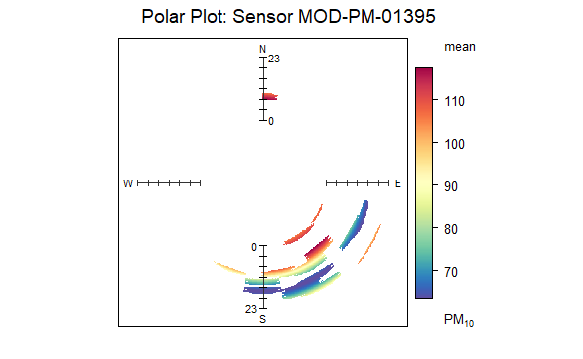
Polar Plots 12/16-12/18
Notes:
What want more of what to put in front of ; what resonates

Slide 32
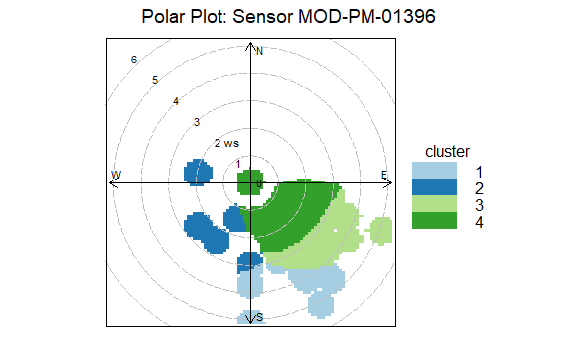
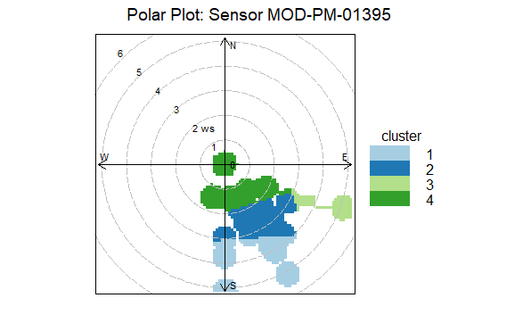
Polar Plots 12/16-12/18

Slide 33
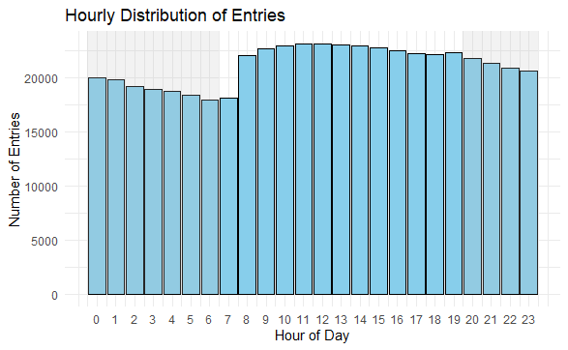

# of entries

Slide 34


Histograms of daily averages
My assumption is that there are peaks that might exceed limit but levels are usually lower at night

Slide 35



Based on the histograms before I was wondering what the peaks were; I focused on pm10 since I was curious about the peaks
This is just a 10 min average and there were high numbers
I thoughts were a bit too high so I instead did a 60 min moving average in case there were just very random spikes but there are still obs that are well above what I expect
I then made time series of the top few

Slide 36










Slide 37
Trendline (slide 10 as ref)

Slide 38

Trendline plot without 12/16-12/18
looks even without the “outlier event” similar but now feb 00 is has highest mean

Slide 39
Trendline plot without 12/16-12/18

Slide 40






Polar plots of pm10 by season

Slide 41






K=100

Slide 42






K=50

Slide 43
Things to do: 3/4
Q
create/update graphs

Slide 44

Histogram of Daily Average PM10 Levels
EPA uses a 24-hour standard of 150 µg/m³.
This standard should not be exceeded more than once per year on average over three years.
shown that it has exceeded three times within a 7 month period
Notes:
% of data points above x

Slide 45

Histogram of Daily Average PM2.5 Levels
primary limit: 9.0 μg/m3, secondary limit: 15.0 μg/m (annual mean, averaged over 3 years)
The average of 2 sensors over a 7 months period is 8.792051
01395: 9.537952
1396: 8.076994

Slide 46



Change trendline Graph
Dec. hours 3-5 still significant even after removing outlier
Removed Feb since it doesn’t represent a whole month; spike on Feb 4

Slide 47


Change polar plots for pm 10
K=100 for the seasonal grpah
Both shows similar information for autumn that there is something southeast
Both summer and winter have 2 months worth of data;
Autumn has 3 months (9,10,11)
Notes:
diurnal - normalized for when they all read the maxes/ peaking and reaching minimum ; if not then they have different sources
Annulus map; are concentrations of 1 and 2.5 coming from the same sources/

Slide 48


hourly polar plots for pm 10

Slide 49




1395
PM 10

Slide 50




1396
PM 10

Slide 51




1395
PM 2.5

Slide 52




1396
PM 2.5

Slide 53


annulusMap 12/16 - 12/18
PM 2.5
PM 10

Slide 54
In Galena Park,

